Slide 1
Introduction to the Metaphor Identification Procedure (MIP)
Susan Nacey
Kognitivt sommerseminar 2009
Hamar
Notes:
Since 2007, I have been working on a doctoral project which has the primary aim of investigating the ‘foreign-soundingness’ of learner-produced written English by comparing the metaphorical competence of advanced Norwegian learners of English with that of native speakers. To do so, I have chosen to compare the extent and characteristics of the Norwegian learners’ production of metaphorical expressions with the metaphorical expressions produced in the same genre by native speakers of English. Argumentative essays collected in two computerized corpora, one corpus consisting of essays written in English by Norwegian students and the other corpus composed of essays written by native speakers of English, provide the primary source material.

Slide 2
Outline
Background
Explanation of MIP
Reflections
susan.nacey@hihm.no
Notes:
Background to development of MIP
Explanation with example
Reflections about reliabiliy and validity, what it’s like to use MIP alone in Norway. A few examples of the types of things I had to consider.

Slide 3
Definition of metaphor
“What, then, is time? I know well enough what it is, provided that nobody asks me; but if I am asked what it is and try to explain, I am baffled.” Saint Augustine
TIME IS MONEY
You’re wasting my time.
This gadget will save you hours.
The (partial) mapping of two concepts belonging to two different knowledge domains onto each other.
One concept (the target) is understood in terms of the other (the source).
susan.nacey@hihm.no
Notes:
First settle on a definition of metaphor

Slide 4
General issues in metaphor identification
No established procedures
Introspection
Unilaterally identify metaphors in discourse
  By the researcher alone
  Often indisputably figurative
  Combined with searches for lexical items in source and/or target domains
Identify through inter-rater procedures
  By several disinterested parties
  Results compared to produce a measure of reliabilty
  An agreement rate of around 75% usually judged acceptable
susan.nacey@hihm.no
Notes:
NO established procedures. Chances are that if we all had the same text, we’d pick out different metaphors
Construct own metaphors: L&J made up their examples. So did Kövesces, who now uses corpus data for examples.
Empirical results, but do they reflect your interests or objective assessments? Messy reality to metaphor use – something which corpus research shows us, and it’s tempting to simply pick out some juicy metaphors and ignore the rest. Plea to avoid sloppy analysis: Be explicit about criteria and procedures, pay greater attention to quantitative analysis, and do more corpus research – keeps us honest.
Raymond Gibbs: Gibbs, Raymond W., Jr. (2006): "The Wonderful, Chaotic, Creative, Heroic, Challenging World of Researching and Applying Metaphor: A Celebration of the Past and Some Peeks into the Future." In RaAM6: Researching and Applying Metaphor. Leeds, UK.
2. Subjectivity: What happens to the borderline cases? Cameron (2003: 59): ”The borderline cases far outnumbered the certain cases…”
And how to compare with others?
Stefanowitsch= Metaphor Pattern Analysis. Searches for all cases of lexical item in target domain (e.g. love), then collect all cases of metaphor and group them according to conceptual metaphor. Compared with Kövesces made-up examples and had found more. Problem= only identifies those metaphors with the key word. A subset of the total
(and how to identify the underlying conceptual metaphor? EX Kövesces has examples of FEAR IS A VICIOUS ENEMY and FEAR IS A TORMENTOR and FEAR IS AN OPPONENT IN STRUGGLE, but Stefanowitch asks why no FEAR IS AN ENEMY. He calls other so-called mapping ”dubious”, but then we hav eot rely on his judgement.
3. What is the def of metaphor? Ex 10 teachers
Pullum calls complete reliance on intuition a discredit to theoretical syntax, as there can be no scientific validity to a “how-does-it-sound-to-you today” methodology conducted “...on the basis of purported facts that are neither intersubjectively checkable nor potentially falsifiable” and “lends itself to abuse.”
Few studies require the researcher to identify all metaphors in a text.

Slide 5
Individual differences in metaphor identification
4 Pragglejaz analysts
Analyzed 5 nineteenth century poems for metaphorically-used words
Only lexical word classes
3 days of preparatory theoretical discussion
Results:
  No reliable statistical agreement
Discussion round
  Reduction of individual bias
  Led to statistical agreement
Errors & oversights, but also important issues
Peter Crisp
Ray Gibbs
Alan Cienki
Graham Low
Gerard Steen
Lynne Cameron
Elena Semino
Joe Grady
Alice Deignan
Zoltan Kövecses
susan.nacey@hihm.no
Notes:
Peter Crisp (HK), Ray Gibbs (Berkeley), Alan Cienki (VU), Graham Low (York), Gerard Steen (VU), Lynne Cameron (Open Univ), Elena Semino (Lancaster), Joe Grady (primary metaphors- Berkeley), Alice Deignan (Leeds) and Zoltan Kövecses (Hungary).
2001 – 2002
No reliable stat. Measure: makes you fear for the worst. How to compare results???
In all, about 6 reliabilty tests, with different genres. All with same results. Not enough agreement before analysis, altho nouns easier to identify plus 75% of the words in most texts were unanimously judged as not metaphorical.
After discussion: performance errors corrected. Most analysts willing to change obvious mistakes.

Slide 6
The Metaphor Identification Procedure
MIP
A practical, systematic, and reliable method for identifying metaphorically-used words in discourse
Developed by Gerard Steen and 5 research assistants at the VU University Amsterdam
Applied to English (BNC Baby) and Dutch
Identifies metaphor in use, i.e. linguistic metaphors
First step in a 5-step procedure which also uncovers the underlying conceptual metaphors
Your claims are indefensible.
I’ve never won an argument with him.
ARGUMENT IS
WAR
susan.nacey@hihm.no

Slide 7
Pragglejaz procedure vs MIP vs MIPVU
MIP = Pragglejaz procedure
Identifies indirectly-expressed linguistic metaphors
    My love is a rose.
MIPVU
Adds details to procedural protocol
Identifies other forms of metaphor involving conceptual metaphor with directly used language
  Simile
    My love is like a rose.
  Analogy
    Bray’s tone had the effect of a metal box slamming shut.
  Expressions of counterfactual reality
    If Clinton were the Titanic, the iceberg would sink.
susan.nacey@hihm.no
Notes:
MIPVU expands MIP by being able to identify metaphor involving directly used language. Also added details on procedural protocol.
Directly used language: In the simile, ”rose” is used in its basic sense, but understanding what is meant requires metaphorical processing.

Slide 8
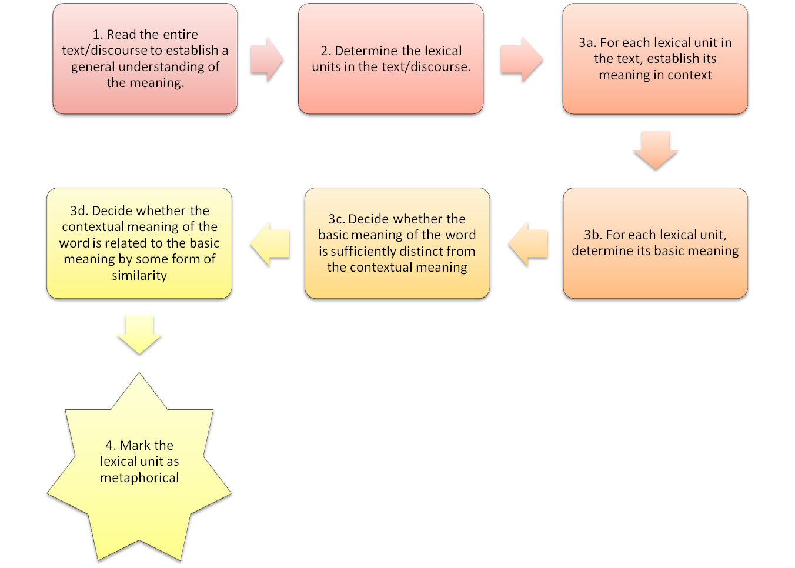

Yes
Yes
No
No
Mark the lexical unit as not metaphorical
The Metaphor Identification Procedure (MIP)
susan.nacey@hihm.no

Slide 9
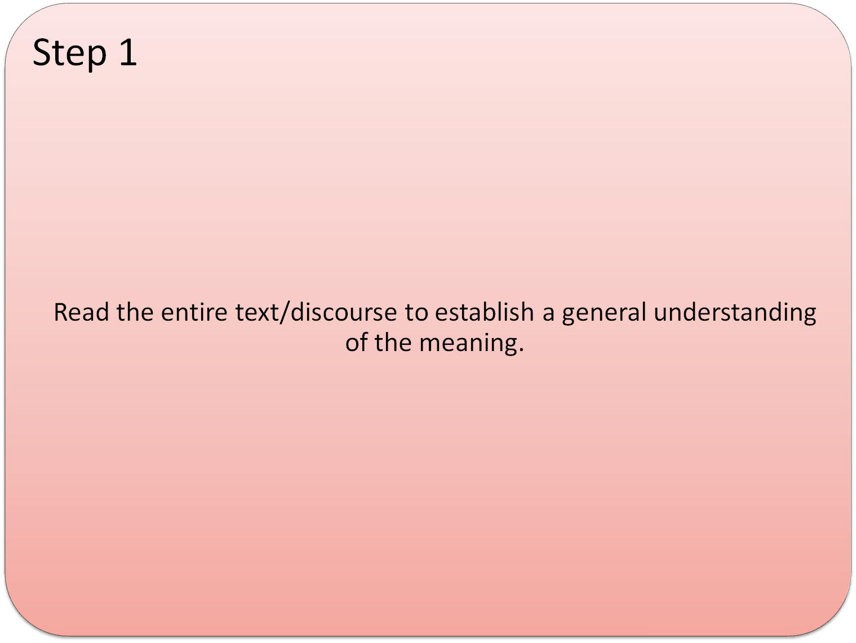
ICLE-NO-AG-0006.1
I love the world and all its problems.
There are lots of small and dusty reasons for this;
drinking coffee with my friends, the surprises
of everyday life, and the feeling of accomplishment when I execute
a job well. The greatest reason of all is that I love to go to bed at
night, knowing that I have hours where my dreams and imagination
can run wild. I get to wake up in the morning and make
yesterday's dreams come true. It's my choice.
susan.nacey@hihm.no
Notes:
The Norwegian subcorpus, NICLE, was collected at various Norwegian colleges and universities between 1999 and 2002, and consists of approximately 300 essays comprising a total of 212,000 words. NICLE includes essays on 17 different topics, and the one which generated the most text (55,978 words) was chosen for the purposes of this project: Some people say that in our modern world, dominated by science, technology and industrialisation, there is no longer a place for dreaming and imagination.

Slide 10
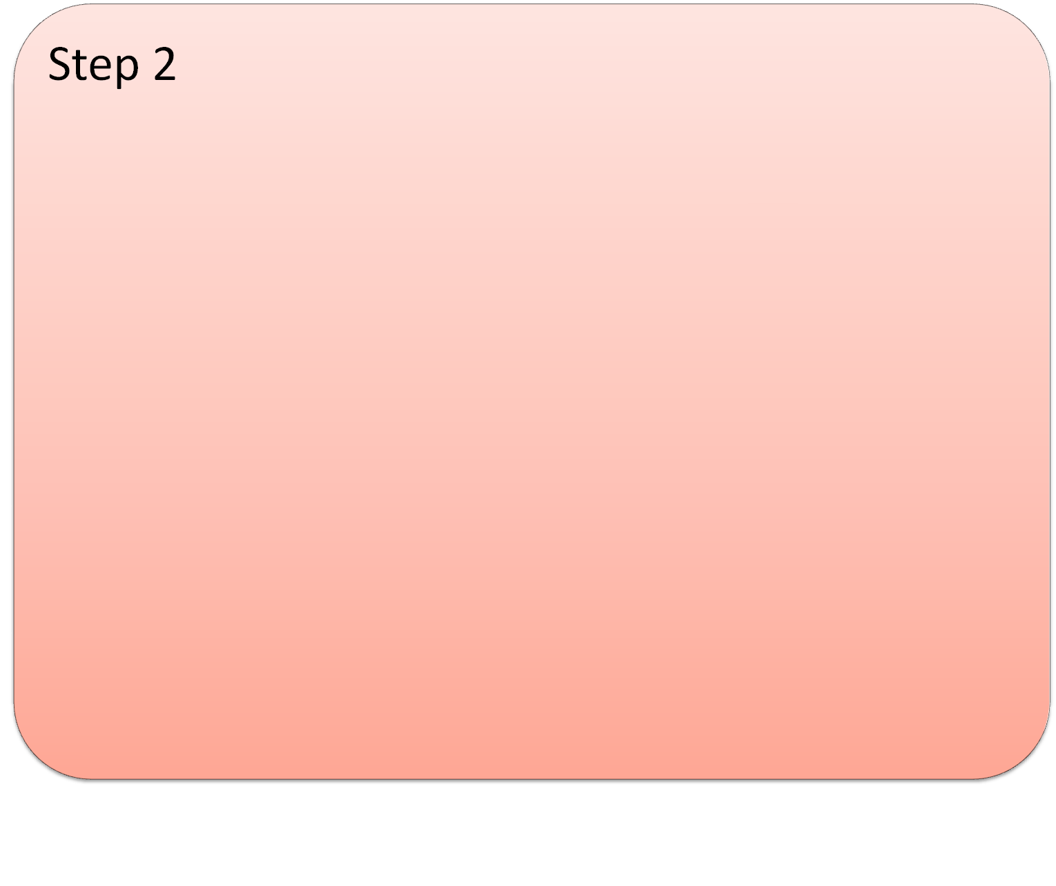
The word is the basic unit of analysis
A sequence of letters bound by spaces on either side
Primary stress on the first word
Main exceptions
Compounds
  e.g. snail mail, cash crop , power plant
Polywords
  Short, fixed expressions which function as individual lexical items
  e.g. of course, according to, faux pas
Phrasal verbs
  e.g. show up, take off
BNC List of Multiwords and Associated Tags
Determine the lexical units in the text/discourse.
BNC POS tags:
AVP
Adverb particle
susan.nacey@hihm.no
Notes:
Words typically evoke concepts. There seems to be a basic correspondence between words and concepts and referents in the projected text world.
Orthographic definition of the word. But som exceptions.
Compounds: Compounds are also treated by MIP as single lexical items because even though the interplay between the individual elements in the compound may involve metaphorical thought (eg stokebroker belt), the compounds as a whole represents only one concept in the real world. When a compound is solid (doghouse, braindrain) or hyphenated (must-have, lift-off), then it is always treated as one lexical unit unless it is not listed in the dictionary. In such a case, it is analyzed as two separate units and treated as a novel construction.
MIP identifies a spaced compound as one lexical unit based both on its being lexicalized and on its stress pattern. In order to be treated as a single unit of analysis, the first element of the phrase in question must have the primary stress (snail mail, cash crop, jet lag).
Stress marks are included in the physical copy of MED, but have been removed from the CD-Rom of its second edition. Instead, one can hear the pronunciation of each word at will. Often, however, the primary stress is given just slightly more emphasis than the secondary stress, so that I was often forced to look up the term in question in the physical copy of the dictionary rather than rely on the my electronic version, a laborious process. Moreover, dictionaries operate with a much broader view of what constitutes a compound, one which is less dependent on stress pattern. Thus, many expressions which are treated as single lexical units in the dictionaries are analyzed by MIP as individual lexical items, such as reality TV, lifelong learning, and the Third World.
Polywords: Polywords are short, fixed expressions such as of course, on top of, even if and that is to say which function as individual lexical items. In other words, they are perceived as single words even though they consist of two or more words (Becker 1975, Nattinger and DeCarrico 1992: 38-39). Sinclair (1991: 110-111) contends that the word spaces in such terms are “structurally bogus” and may eventually disappear (as in the words maybe and nevertheless), because their individual components have “lost their semantic identity.” MIP treats polywords as single lexical units and defines them in accordance with the BNC List of Multiwords and Associated Tags (http://www.natcorp.ox.ac.uk/docs/multiwd.htm). This list also includes certain foreign expressions which have entered the English language such as faux pas and tabula rasa.

Slide 11
I love the world and all its
problems. There are lots of small
and dusty reasons for this…
susan.nacey@hihm.no

Slide 12
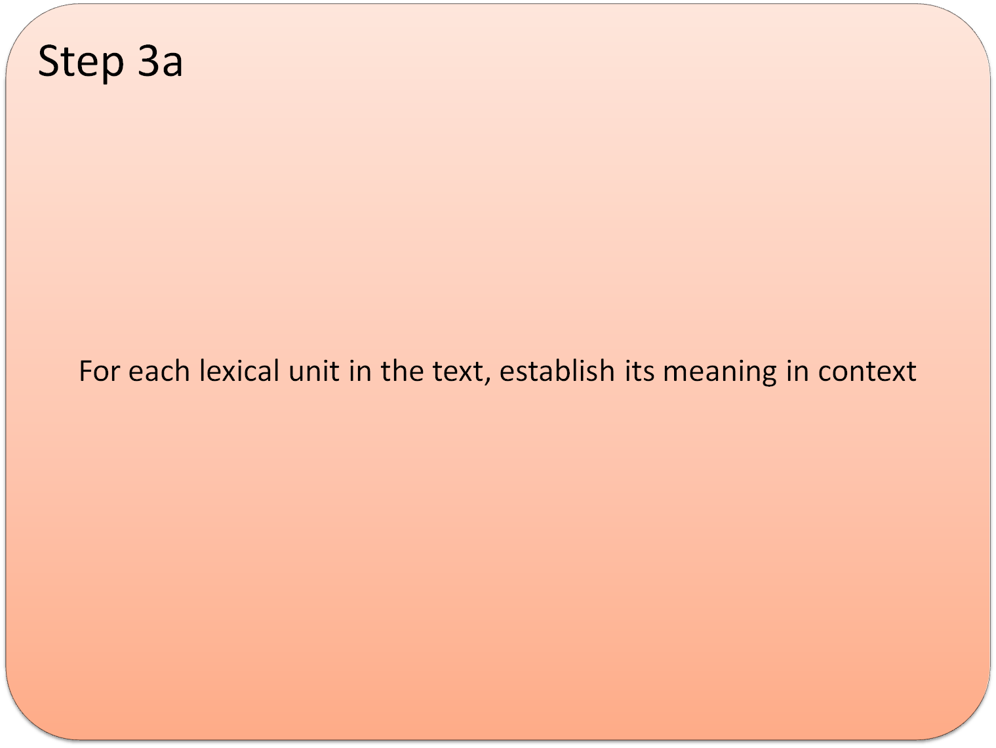
There are lots of small and dusty reasons
Old
Complicated
Hidden
Layered
Covered
Cherished
????
susan.nacey@hihm.no
Notes:
As Cameron states, “[i]n metaphor studies, strong, active poetic metaphors have commonly been placed at the centre of the category as prototypes” (Cameron 2003: 61). Metaphorical language becomes most conspicuous as a result of either especially elusive or sensational qualities, and therefore such expressions tend to receive the most attention (Steen and Gibbs 2004). In the discourse of language philosophy, the terms “strong” and “active” are closely associated with novels metaphors, having gained prominence in Max Black’s writings on his interaction view of metaphor. According to Black, active metaphors are those “needing no artificial respiration” (Black 1993: 25), and as a consequence the only type of metaphor worthy of study. Although aware that any part of speech may be used metaphorically, he maintains that “the results are meagre and uninteresting” (Black 1981: 80). Creative metaphors generate the most interest because they are the most salient. Moreover, if Gentner and Bowdle’s career of metaphor theory has any merit, then novel metaphors are the only ones that require metaphorical processing on a conceptual level. They “defamiliarize the reader and provoke extra interpretative work” (Cameron 2003: 108). Indeed, philosophers have noted that the potent metaphor produces endless alternative interpretations, while simultaneously being irreducible. As Cohen remarks, “[i]f it is rich enough, then although it can be paraphrased and explicated, it will have no complete ‘translation’ – there will be no substitute which says all that it says without remainder” (Cohen 1976: 250). Anecdotal evidence also suggests that the layman perceives novel metaphors as prototypical. In schooling, metaphor is typically presented as a literary device, exemplified in poetry and classical works of literature rather than as an intrinsic part of everyday discourse. Such focus on novel metaphors is somewhat ironic, given that they are anything but typical. Steen, for example, maintains that “99% of all metaphor in discourse appears to be conventional as opposed to novel...” (Steen 2008a: 227). This supposition is borne out not only by his own research, but by my investigation as well.

Slide 13
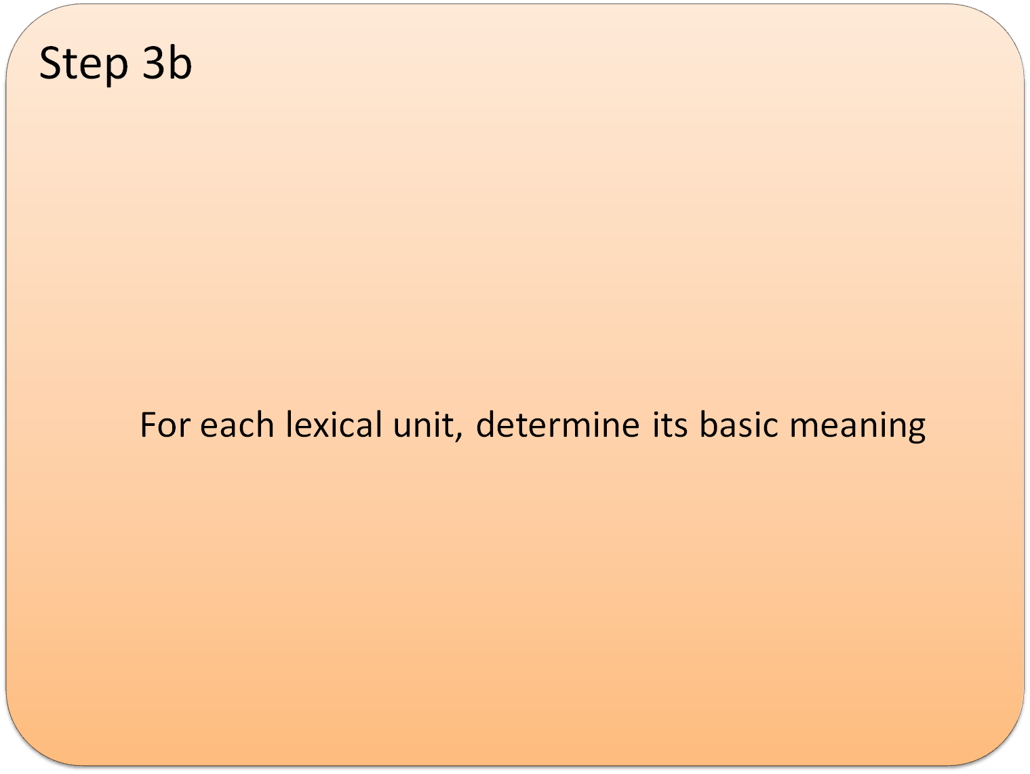

Basic meaning
Accessible to the senses
Cognitively
more structured
The most
concrete,
precise,
and human-oriented sense
you can find in the dictionary
within one word class
and grammatical subcategory
typically historically older
Related to bodily action
e.g.
noun vs verb
e.g. countable vs uncountable
susan.nacey@hihm.no
Notes:
Concrete: What they evoke is easier to imagine, see, hear, feel, smell, and taste
Precise: as opposed to vague
Human-oriented motivated: by the human body sensory motor apparatus
both word class (noun, verb, preposition, conjunction, etc) and grammatical category (countable/uncountable, transitive/intransitive/copular, etc) are considered integral to the meaning of the lexical unit in context based on the view that the individual components of a language are defined by both their semantics and required syntax. In other words, particular word classes identify particular concepts and referents, and thus should not be altered when establishing the basic meaning.

Slide 14

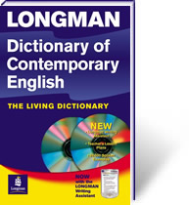
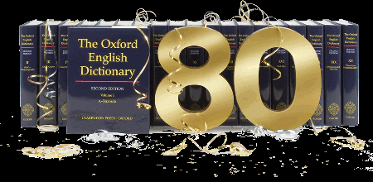
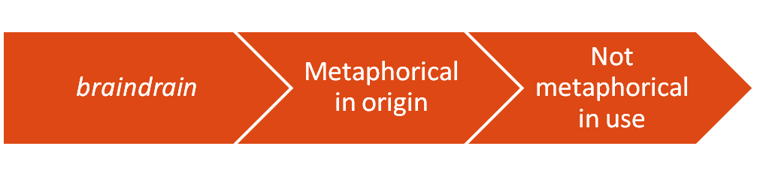
“The dictionary”
Corpus-based ESL dictionaries
List the most frequent sense first
This sense is NOT necessarily the basic sense
MIP is “…concerned with what is metaphorical within the text world, not with uses that may have been derived through a metaphorical process at some previous time”
susan.nacey@hihm.no
Notes:
The term “the dictionary” is simply meant to be shorthand to refer to the actual dictionaries which MIP advocates. As its primary dictionary for determining basic senses, MIP uses the Macmillan Dictionary for Advanced Learners (MED), a dictionary based on a fairly recent corpus of contemporary English and intended for the general language user. Also have illustrative sentences.
In cases of doubt, especially when MED had conflated senses, then the Longman Dictionary of Contemporary English (LM), also corpus-based, is consulted to resolve the question.
Most frequent/salient sense not necessarily the basic sense. Could be metaphorical. Also difficult to determine!
Contemporary dictionaries such as MED and LM were chosen because MIP is “…concerned with what is metaphorical within the text world, not with uses that may have been derived through a metaphorical process at some previous time” (Pragglejaz Group 2007: 16).

Slide 15
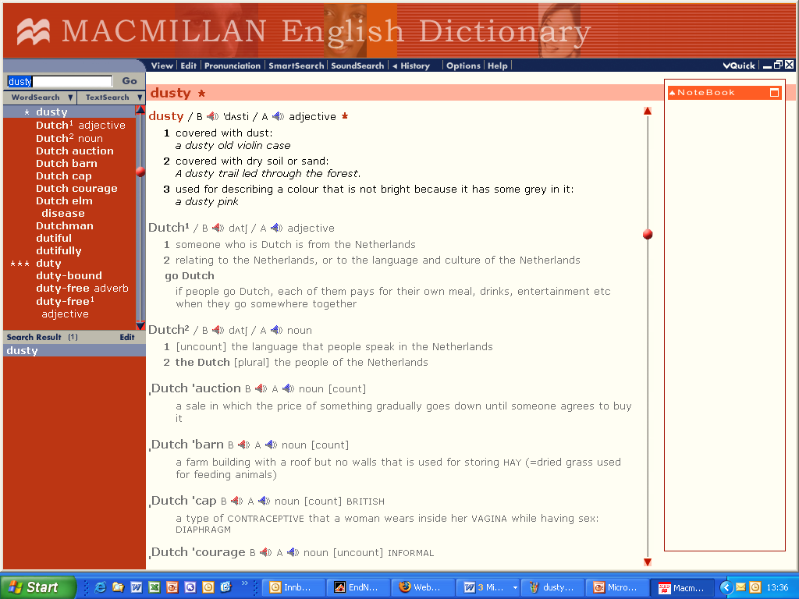
The basic meaning of dusty
susan.nacey@hihm.no

Slide 16
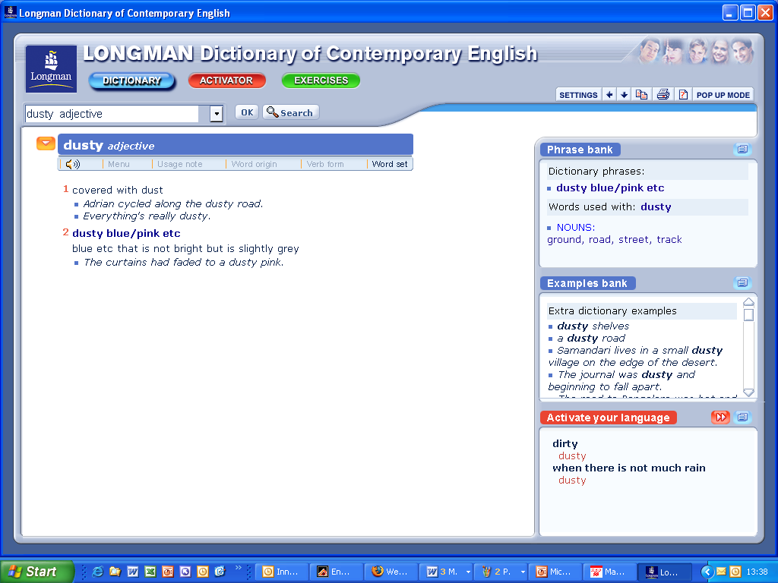
susan.nacey@hihm.no

Slide 17
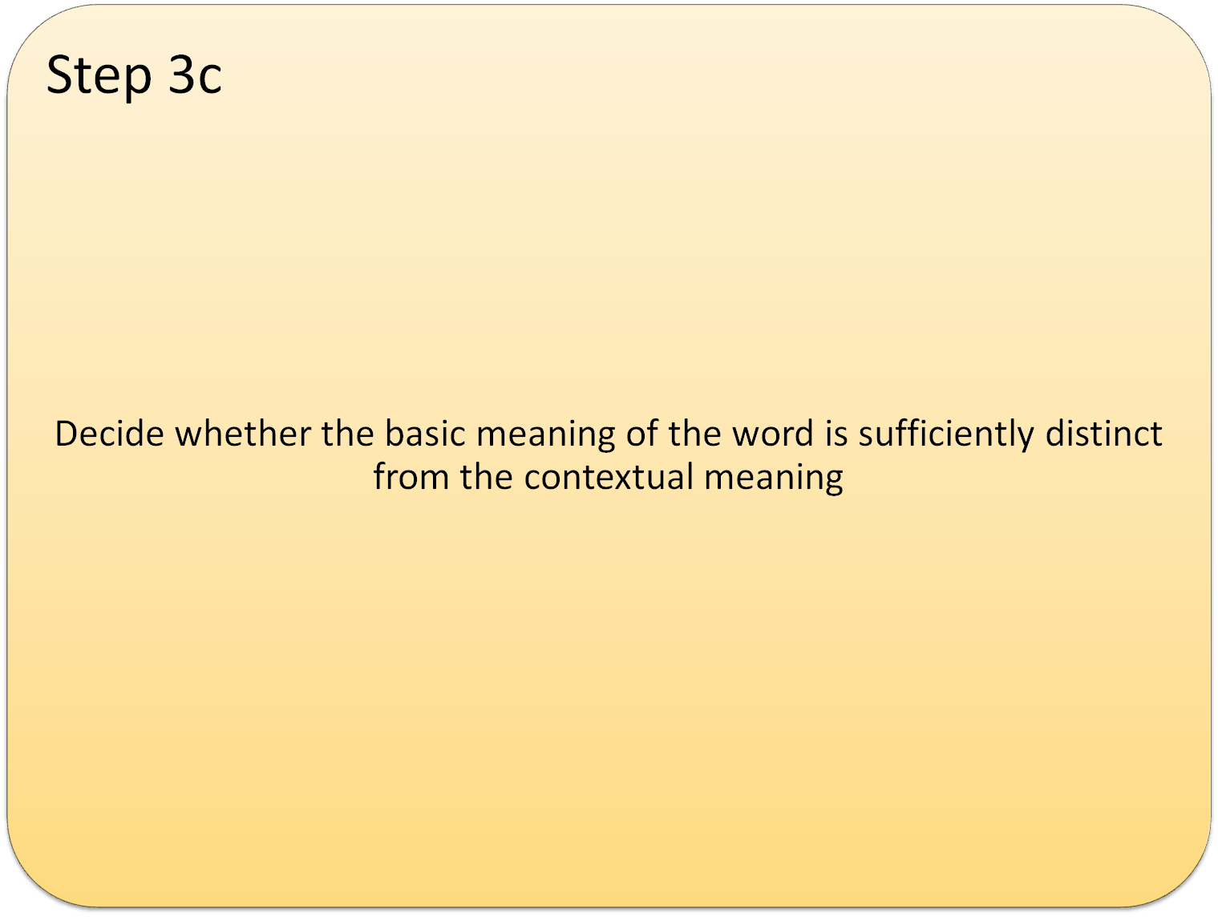
Different senses of a specific lexical unit are distinct enough when they have separate, numbered senses in the dictionary.
  i.e. the lexical unit has to be polysemous
Different senses under the same sense description differentiate manifestations of the same core meaning.
susan.nacey@hihm.no

Slide 18
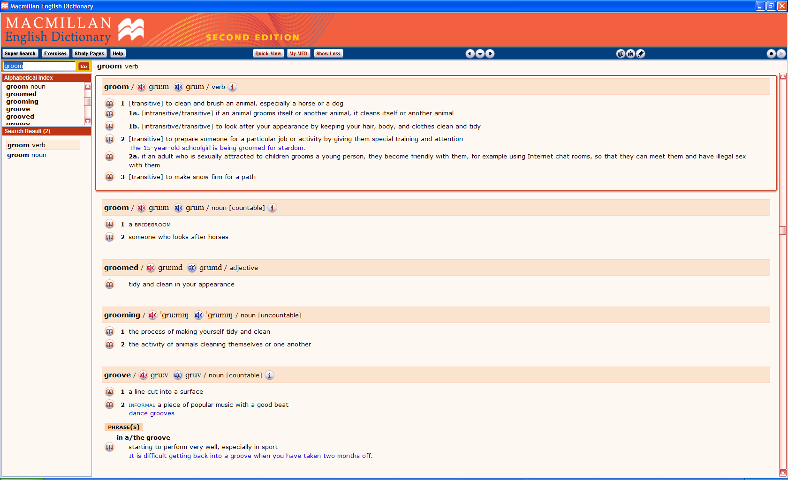
susan.nacey@hihm.no

Slide 19
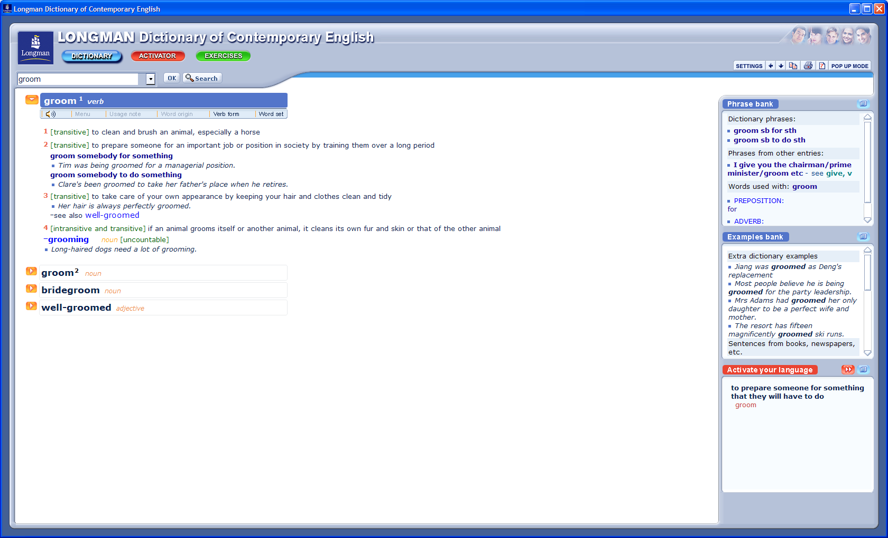
susan.nacey@hihm.no

Slide 20
There are lots of small and dusty reasons
The contextual meaning is not quite clear: old, complicated, hidden, layered, covered, cherished (?)
The basic meaning is “covered with dust”
Yes, the basic and contextual meanings are distinct from each other.
susan.nacey@hihm.no

Slide 21
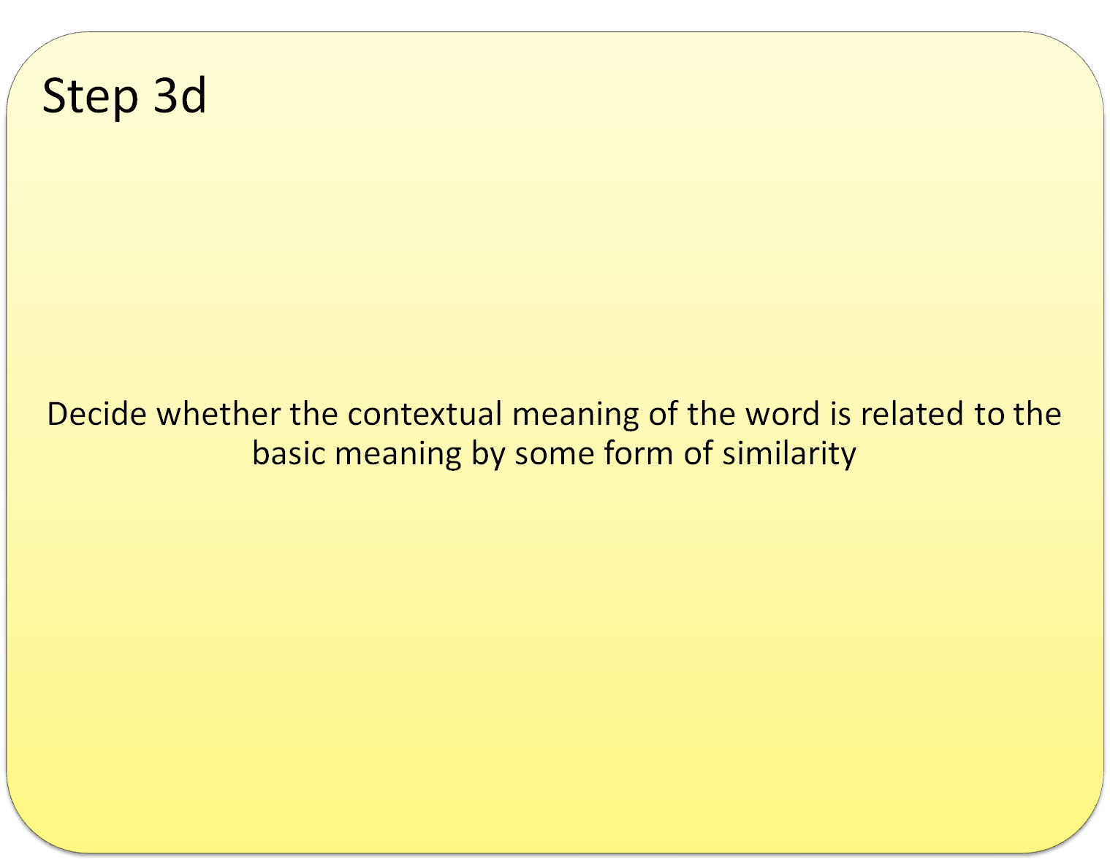
Other types of relationships are possible, e.g.
  Metonymy
  Specification
  Generalization
  Hyperbole
MIP adopts a broad view of similarity
”Similarity can encompass pre-existing as well as created similarity; and it can include literal or external similarity (or resemblance) as well as relational or proportional similarity (or analogy).” Steen (2007: 63)
I see what you mean
to cheat
appeal (n)
I’m afraid I can’t help you
susan.nacey@hihm.no
Notes:
Metonymy: borderline between metaphor and metonymy is fuzzy. Metonymy relies on contiguity or co-occurrence (understand X via Y), whereas metaphor relies on similarity (understand X as Y). Something that is contiguous can also be similar, so just because metonymy is involved doesn’t mean that metaphor is excluded.
Can be linked.
2 people looking at text = metonymy. 2 people miles apart = metaphor
SEEING IS UNDERSTANDING.
Adopting a particular perspective, where similarity more relevant than contiguity.
Seeing is often a precondition for understanding.
Specification: cheat (v) dishonesty. Cheating on a person = a specification of dishonest behaviour
Generalization: appeal (n) legal request. But also a request in a more general sense (e.g. for charity)
Hyperbole: afraid (adj) to feel fear. But then phrase I’m afraid that I can’t help you. Obvious exaggeration.
MIP adopts a broad view of similarity, where it “…can encompass pre-existing as well as created similarity […and…] literal or external similarity [or resemblance] as well as relational or proportional similarity (or analogy)” (Steen 2007: 63).
A- pre-existing. Can also be for ex posited or perceived similarities. Also explains why there can be contradictory mappings, Ex marriage as a business partnership (equals) or as a parent-child relationship (unequals)
B- can be similarity in structure not substance (ex computer virus)
C- doesn’t have to be symmetrical similarity

Slide 22
Dusty
Yes, the two meanings are related by similarity:
A dusty reason is compared to a concrete object which is covered in dust, with all that that entails
susan.nacey@hihm.no

Slide 23
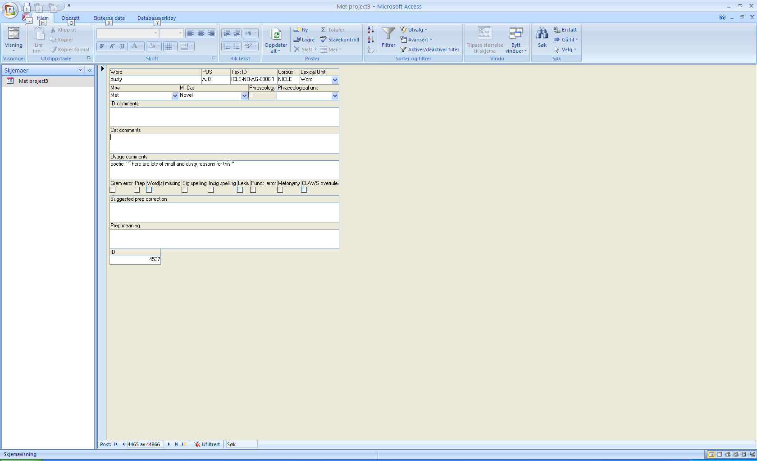
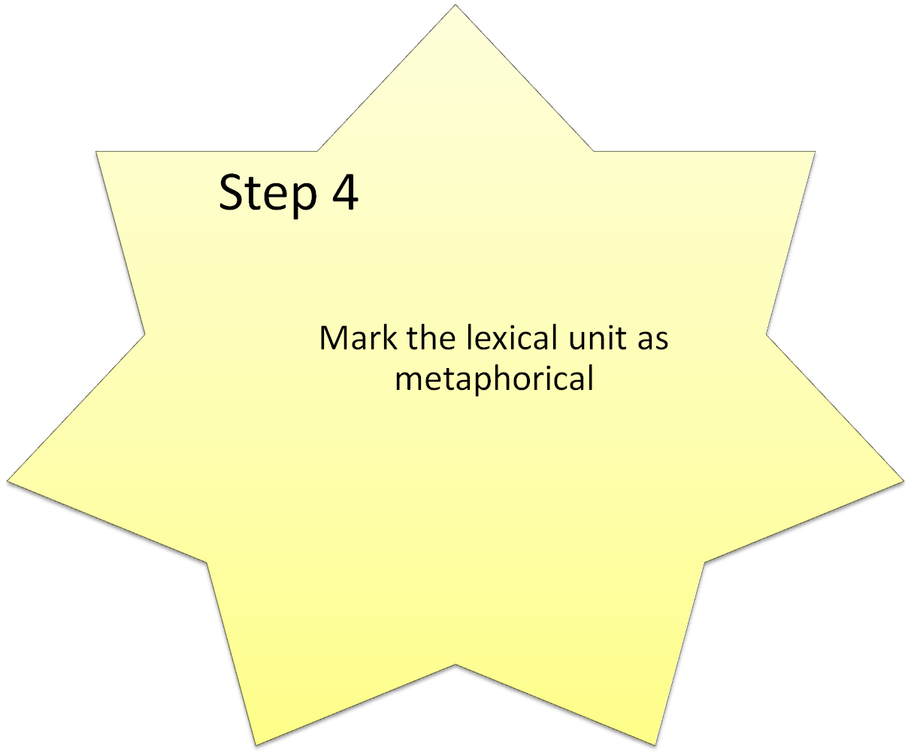
susan.nacey@hihm.no

Slide 24
Reliability and Validity
MIP reliability tests
3 different teams of analysts
English:
  5 separate tests, 2005-2007
  news, fiction, conversation, academic
Dutch
  6 separate tests, 2006-2007
  news and conversation
Results
High, solid, consistent reliability
Also true for Dutch and a different dictionary
Unanimous agreement before discussion in roughly 92% of all cases
Analysist bias alleviated by analysis protocol
susan.nacey@hihm.no
Notes:
From unpublished handbook: A Method for Linguistic Metaphor Identification: A Casebook
Researchers have a duty to show that their findings mean something, and are not just figments of their imagination.
Protocol of analysis calls for discussion and group meetings, with decisions about problematic cases being stored in a lexical database for future reference. GVAP= Group verdict after Pragglejazzing

Slide 25
Practical considerations
Time-consuming
Measurer performance
Practice effect
susan.nacey@hihm.no
Notes:
Time-consuming. MIP originally planned on identifying 100,000 each words in 4 genres. Stopped at 50,000. Similarly, I had originally planned on identifying 100,000 (50,000 of each), but stopped at a total of 40,000. A good solid year. Mentioned this to MIP researchers, and they were impressed.
Measurer performance. Stamina. 2 passes are recommended!
Practice effect. Have to remember what has been decided before. MIP did this by way of weekly discussions abt difficult decisions plus created a special website. Reminders. Database helps. Note that this is radically different from what usually happens in empirical research.

Slide 26
“Metaphor identification, and specifically using MIP, is hard work and must be done slowly…” (Pragglejaz Group 2007: 36)
Technical error in registration
Oversight
Misunderstanding of procedure
Lack of consistency
Genuine disagreement with what MIP identifies
susan.nacey@hihm.no
Notes:
One contributory factor involves the technical process of registering metaphor. Any system must have some means of data collection, which in my case a Microsoft Access table. The analysis of 40,000 lexical units consequently affords 40,000 chances to click the wrong button and thereby unintentionally register the degree of metaphoricity incorrectly. Such potential for error is multiplied by the number of factors one is trying to register. A second potential cause of error lies in sheer oversight or lack of consistency. Metaphor identification of large amounts of text involves many, many hours of concentrated work in front of a data screen, so that even the most careful researcher is likely to miss even obvious metaphors on at least a few occasions. As the Pragglejaz Group admits, “[m]etaphor identification, and specifically using MIP, is hard work and must be done slowly…” (Pragglejaz Group 2007: 36). Furthermore, differences can arise as a result of a misunderstanding of the procedure, especially in the beginning stages when one is first trying out MIP. Such problems, however, are likely to be ironed out before too much text has been analyzed. A fourth and more serious potential cause of discrepancies may lie in a genuine disagreement over something which MIP has or has not identified as metaphorical. The individual judgement of the researcher plays a definitive role even with such a clearly outlined process as MIP. Slavish adherence to the MIP is neither possible nor desirable. Although researchers are likely to agree in a majority of core cases, more marginal instances may be disputed. These might include issues relating to the metaphoricity of function words such as demonstrative pronouns and determiners, as well as those prepositions whose basic meaning may be very obvious.

Slide 27
MIP and the isolated Norwegian researcher
Unaffordable luxuries:
  Collaboration à la VU Amsterdam
  2nd pass of entire material
Internal consistency
  Reanalyzed 4 texts, 2 months after completion of 1st pass
  2090 words
  23 lexical units reclassified
    2 typos
    10 oversights (6 lexical words, 5 function words)
    11 problems of consistency
      dead metaphors
      preposition of
      Lexical error (expert written instead of expect)
susan.nacey@hihm.no

Slide 28
”The slippery nature of the term” abstract
Being a kid, with no worries. ICLE-NO-AC-0009
Basic meaning of with:
  together (MED1)
    Hannah lives with her parents.
  having or holding something (MED2, if concrete)
    a girl with red hair
    We saw Moore coming back with a drink in his hand.
  by means of something (MED3, if concrete)
    Stir the mixture with a spoon.
To decide whether with is metaphorical in use, one must therefore decide whether its collocation is concrete or abstract
susan.nacey@hihm.no
Notes:
Grady (1997) discusses “the slippery nature of the term” (Chap 1, p 28) abstract in his dissertation about primary metaphors. He maintains that a commonly-held view is that abstract concepts
…are abstract in the sense of being higher-order intellectual constructs, less directly experienced than source concepts. Given such an understanding, target concepts would presumably be the products of relatively sophisticated powers of invention or analysis, might for this reason be inaccessible to children, and so forth. (Chap 5, p 21)
Under this view, concepts such as happiness and similarity would not be considered abstract because they are easily accessible elements which are basic to our cognition, unlike for example, complicated legal and moral concepts. Leech, however, notes that concepts such as these are traditionally regarded as abstract. His explanation is that these are “semantically represented by rank-shift predications with empty terminal clusters,” so that e.g. “‘kindness’ = ‘(someone’s) being kind’” (Leech 1969: 103).
Grady prefers to define abstract as those concepts which lack image content, by which he means the cognitive representation of experiences which are tied to direct physical sensation or perception, to our bodies and the environment around us. Image content is thus related to bodily sensory and sense input in any modality. They “…have obvious physical referents, either in properties of the physical world or in sensations we experience,” (Chap 5, p 8) whether those sensations be visual, auditory, tactile, etc. Following this definition, happiness and similarity are indeed abstract, because they involve responses to our direct perceptions rather than those perceptions themselves, unlike our perceptions of e.g. brightness or sweetness. Abstract concepts are thus “less strongly associated with specific sensory experiences” (Chap 1, p 28). Such an idea of being less strongly associated, however, introduces an element of individual evaluation into the determination of abstract or concrete. How weak does this association have to be, and how is its strength to be judged?
Danesi also explicitly tackles the question of abstract and concrete by offering working definitions derived from the idea of concept formation in both philosophy and psychology, whereby the term concept simply refers to a classification strategy. Although he concedes that the debate about concrete concepts “is an ancient one and still largely unresolved” (Danesi 2001: 136), he does nevertheless offer explicit definitions, maintaining that “a concrete concept is one that is demonstrable in a direct way, whereas an abstract concept is one that cannot be demonstrated or observed directly (Danesi 2001: 135). This is a seemingly simple distinction – a table is concrete, hatred is abstract. Concrete concepts refer to perceivable things whereas abstract concepts refer to notions such as emotions and ideas (Danesi 2004: 401-402).
He expands on these simple definitions by explaining that “concrete concepts” have “concrete referents” which in turn belong to particular “concrete conceptual domains”. For instance, the concrete referent for a color gradation between certain specified wavelengths is blue. Blue, together with other similar concrete referents such as red and yellow constitute the concrete conceptual domain of color. He specifies that such particular concrete referents are not necessarily universal, however, as different cultures for example divide color categories in different ways. The concept of color, in its turn, is a “unitary concrete concept,” which is directly experienced through our senses and emerges before abstract development in human development. Danesi holds that there are other “associative concrete concepts,” such as vision, which are experientially linked with the unitary concrete concepts. Such derived a concept is not abstract “association-by-sense” which comes from experience and thus can be easily demonstrated” (Danesi 2001: 138).
Here; worries = abstract. Our perception of something.

Slide 29
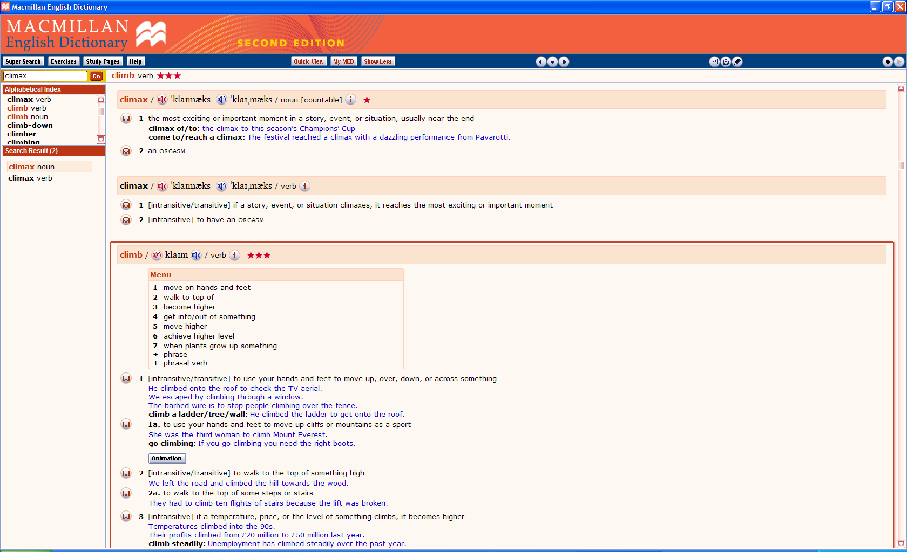
Relationship between lexical entries
susan.nacey@hihm.no
Notes:
MED2 = metaphor or specification. WIDLII
Longman: most important part of a story or experience
OED rhetorical use from 1589. physiological sense from 1918.

Slide 30


Conceptual mappings
Concrete to abstract mappings
Concrete to concrete mappings
Abstract to concrete mappings
susan.nacey@hihm.no

Slide 31
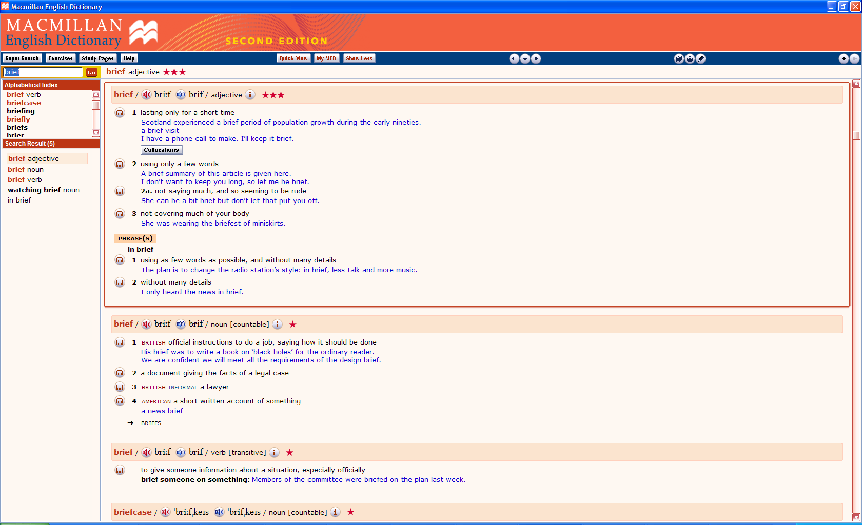
susan.nacey@hihm.no
Notes:
The most concrete definition of brief in MM is MM3 not covering much of your body and hence should be the basic sense if one follows the MIP to the letter.

Slide 32
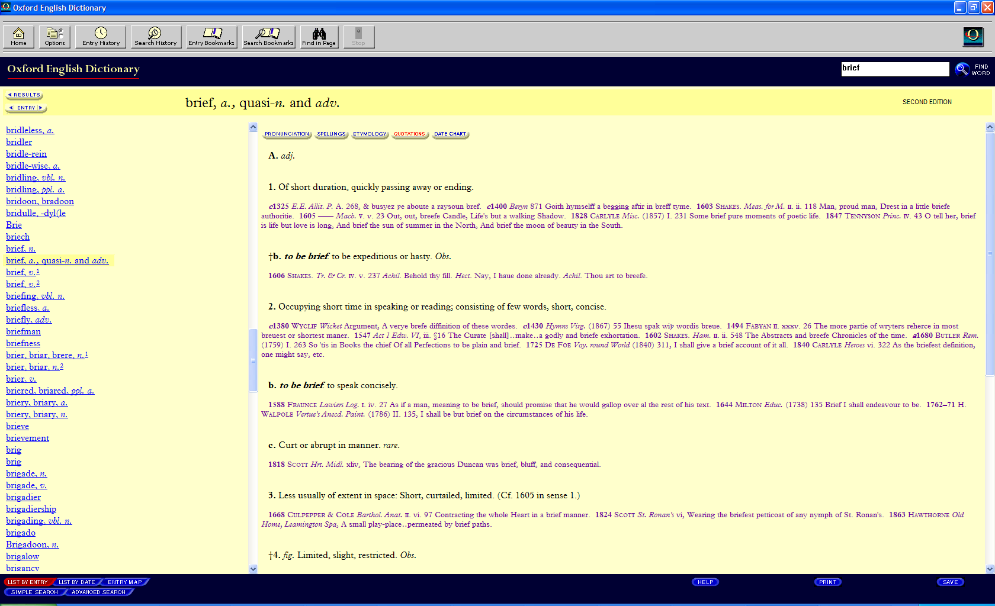
susan.nacey@hihm.no
Notes:
Brief
However, the OED shows that the oldest sense of the word, from 1325 is the MM1 lasting only for a short time, and that this is followed in 1380 by MM2 using only a few words. The sense of MM3 is listed in the third entry of the OED Less usually of extent in space, first appearing in the 1600s.
I would argue that the basic meaning of brief is MM1, MM2 is a logical extension (as anything spoken/written which is brief also tends to contain few words). MM3 is metaphorical, with an unusual abstract to concrete mapping, from time to space.
MM1 = most frequent, and most salient

Slide 33



Conclusions
Historical linguistic metaphors (e.g. fervent, ardent)
Metaphorical in origin but not in use (e.g. braindrain, to squirrel)
Conceptual metaphors
Dilemma: Imposing a binary distinction on something as complex as language
  Semantic domains
  Metaphor vs metonymy
  Abstract vs concrete
  Lexical units
Does the essence of metaphor become lost with such a concentration on the word level?
susan.nacey@hihm.no
Notes:
Historical metaphors where the original meaning is not longer in contemporary use. A subcategory of a wider group, namely Met in origin.
Met in origin: Deignan for ex shows that a large number of literal nouns have metaphorical verbs. Ex animals (pig out, dog, squirrel away)
Conceptual metaphors are reflected in speech, which makes linguistic metaphors important. Linguistic metaphors are the evidence for conceptual metaphors.
In determining metaphoricity, the analyst is faced with all sorts of decisions, the true answers to which are never exact, but are shrouded in a veil of ambiguity and fuzziness. Where does one semantic domain end and another pick up? Can one always clearly distinguish between metaphor and metonymy? Where does one draw the line between abstract and concrete? Are the dividing lines between lexical units always so clear? Should one distinguish between those terms that are metaphorical in use and those which are metaphorical in origin, or does that lead to the essence of metaphor being lost?
Yes/no/don’t know. Making decisions the whole way about a graded phenomenon (see e.g Patrick Hanks– some metaphors are more metaphorical than others)
A bit coarse, yes, but anything finer also makes the assumption that such a measurement can be carried out in more precise ways. How, for ex, would you rank degrees of metaphoricity? Rank scale. Ranked in relation to each other. Interval scale, ratio scale…
Word level: Stefanowitsch: corpora are principally accessed via word forms (orthographic strings).

Slide 34

Still…
d
Makes the process of metaphor identification explicit by forcing the analyst to make clear decisions which can be traced and explained if need be, rather than based on intuition alone
Transparency, reliability, validity
Can be combined with other corpus-based methods
If performed on large amounts of text, MIP generates a great deal of data for further exploration
susan.nacey@hihm.no
Notes:
Most projects don’t require the researcher to identify each and every metaphor, so it’s no necessary to spend months/years gathering data. Can be used in combination with other methods? Ex Stefanowitsch’s Metaphorical Pattern Analysis (captures a subset of met expressions – those containing specific met patterns)
Eyeing the material is simply not satisfactory

Slide 35
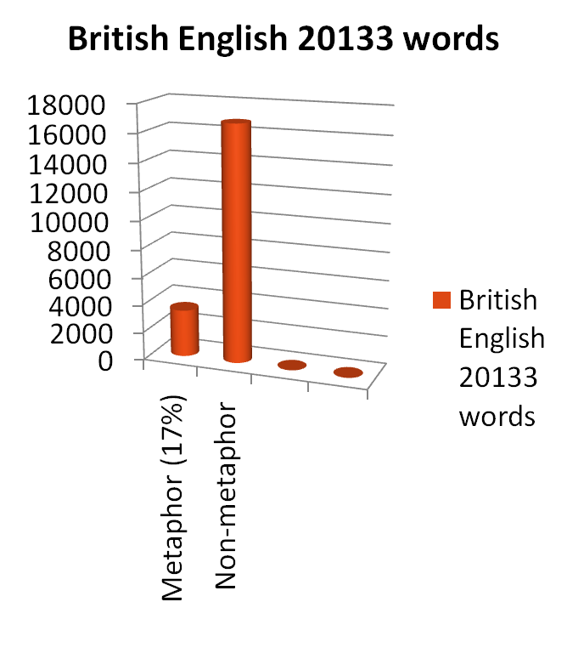
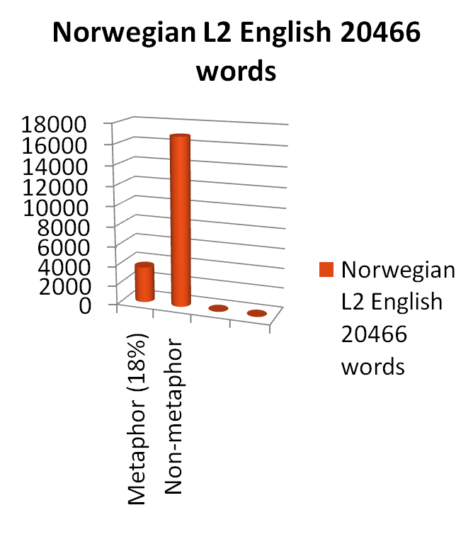
Metaphorically used words
susan.nacey@hihm.no

Slide 36
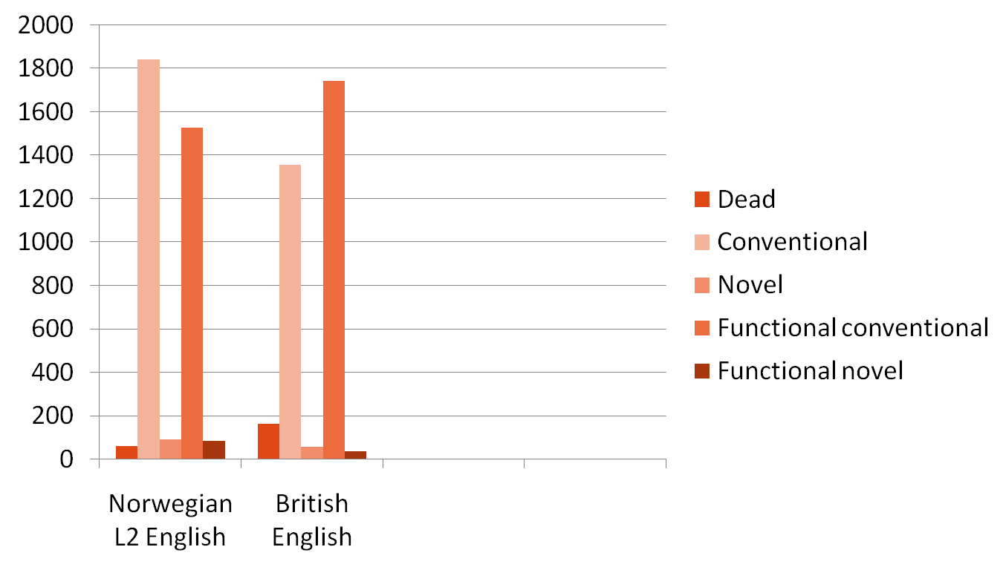
Degree of conventionality
susan.nacey@hihm.no
Notes:
Goatly: conv= tired and sleeping. But how to put into these categories?

Slide 37
References
Lakoff, George and Mark Johnson (1980): Metaphors we live by. Chicago: University of Chicago Press.
Pragglejaz Group (2007): "MIP: A Method for Identifying Metaphorically Used Words in Discourse." In Metaphor and Symbol, vol. 22 (1), 1-39.’
Steen, Gerard (2007): Finding Metaphor in Grammar and Usage. Amsterdam: John Benjamins BV.
Steen, Gerard (1999): "From linguistic to conceptual metaphor in five steps" In Metaphor in Cognitive Linguistics. J. Raymond W. Gibbs and G. Steen (eds.). Amsterdam: John Benjamins.
susan.nacey@hihm.no

